Slide 1


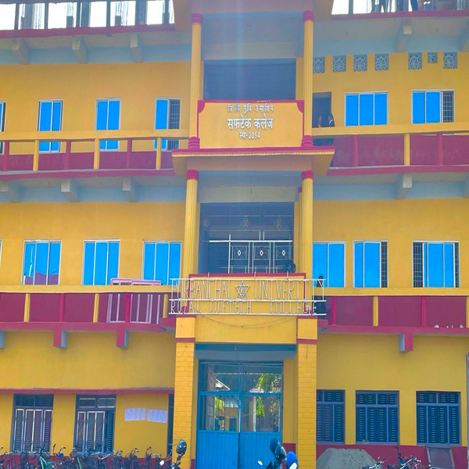

Welcome to Class 11
Royal Softech College, Lahan-3

Slide 2
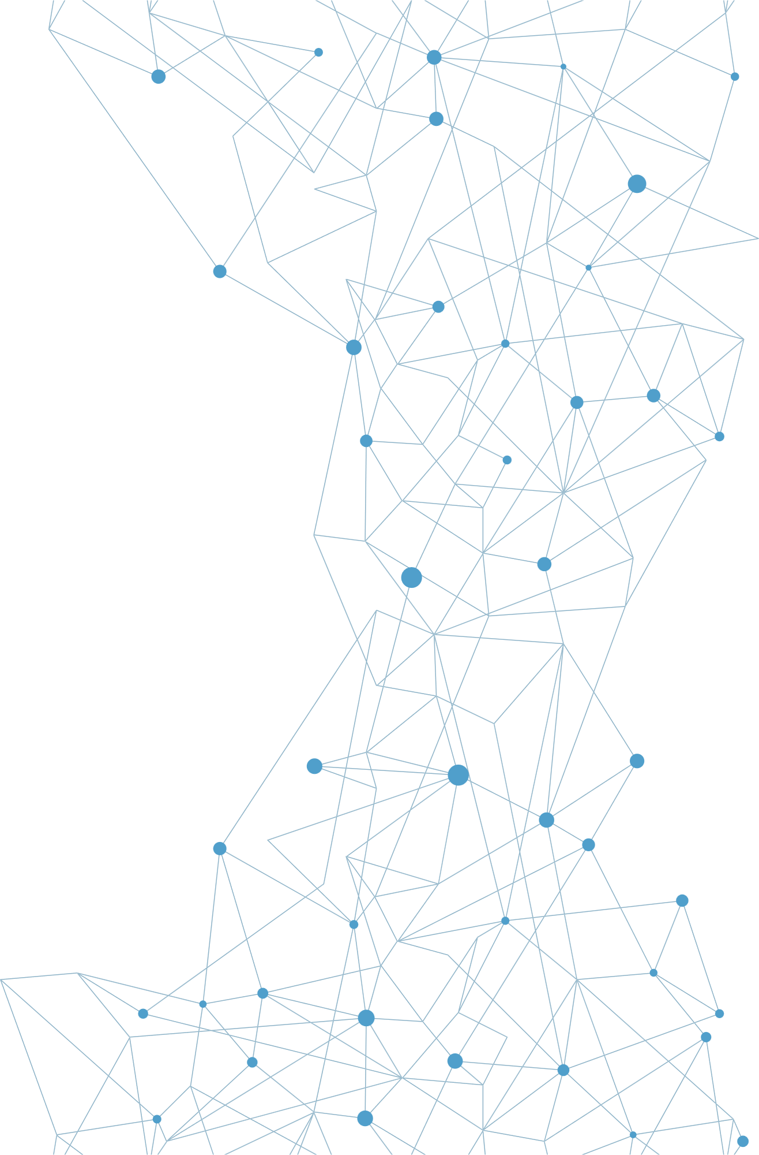
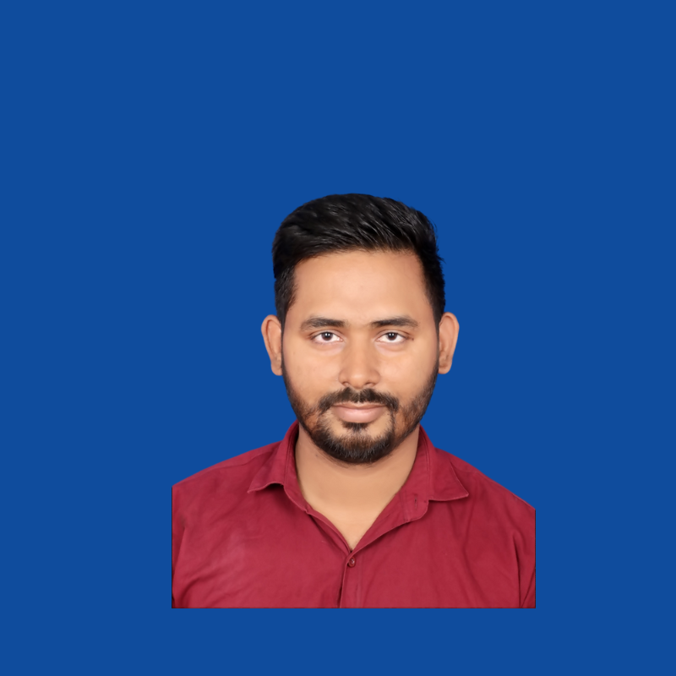
Who am I?
A SHORT INTRO
Name: Ajay Shah
Address: Lahan-4, Siraha
Qualification: B.Tech Information Science & Engineering
Experience:
2+ year as a Computer teacher in Royal Softech College
Branch Manager at Mero Discounts Pvt.Ltd
2 year in Digital Marketing
1+ year in Web Development
Owner at Kharidzone.com

Slide 3

WHY TO STUDY COMPUTER?

Slide 4

WHY TO STUDY COMPUTER?
World of Technology is Growing Rapidly
Every Industy is Demanding Computer Skills
Higher Scope of Jobs all Over the World
High Paying & Home Based Jobs of I.T.

Slide 5
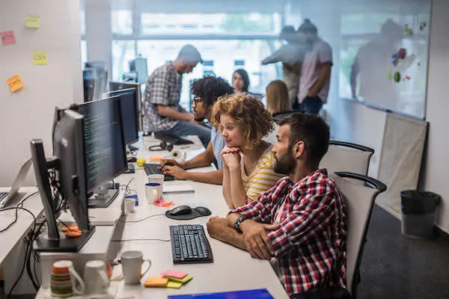
JOBS AVAILABLE
Data Management & Analysis
Digital Marketer
Graphic Designer
Computer Teacher
Website Developer, Application Developer, Software Developer

Slide 6



Contents
Unit – 1 : Computer System
Unit – 6 : Web Technology I
Unit – 2 : Number System & Conservation Boolean Logic
Unit - 7 : Multimedia
Unit – 3 : Computer Software & Operating System
Unit – 8 : Information Security & Cyber Law
Unit - 4 : Application Package
Unit - 5 : Programming Concepts & Logics

Slide 7
UNIT – 1 : Computer System
Define Computer./ What is Computer?
A computer is an electronic device that takes input from the user, processes it, and gives the output in the desired form to the user & stores it if necessary.

Slide 8
UNIT – 1 : Computer System
Characteristics/ Features of Computer
1. Speed: Computers can process data and perform calculations at incredibly high speeds, often completing tasks in seconds that would take humans much longer.
2. Accuracy: Computers are designed to perform operations with a high degree of accuracy, minimizing errors. If the error occurs in computer it is due to wrong input from user.
3. Diligence: The computer can perform repetitive tasks without being bored & never gets Tired. If human beings repeatedly perform task , they suffer from tidredness, weakness, and loss of concentration but the computer can repeatedly perform task with same speed & accuracy.

Slide 9
UNIT – 1 : Computer System
Characteristics/ Features of Computer
4. Versatility: Computer can perform different task depending upon the different program fed to it, is known as versatility. It can do different types of jobs. It can also perform multiple task at the same time.
5. Automation: A computer is an automatic machine, capable of functioning automatically, once the instruction and data are given to it.

Slide 10
UNIT – 1 : Computer System
Capabilities of Computer
The computer is capable of producing 100% accurate outputs, perform complicated calculations & operations at extremely high speed.
It is capable of storing huge amount of data and retrieving(access) it whenever required.
It provides cheapest communication by using transmission media.
It can perform multiple types of works.
It can perform task automatically after required instruction & data are provided.

Slide 11
UNIT – 1 : Computer System
Limitation of Computers
The computer is a dull machine(No brain/ sense). It cannot think and take decisions.
It cannot operate without battery or electricity.
It requires instruction to perform any task. It cannot perform any task by itself.
It cannot learn, think, reason or react like humans.
Failure of device/ software can give wrong output.

